Slide 1




STAFF SHIFT SCHEDULING AND MANAGEMENT SYSTEM
GROUP: CAFE
CMT109 - DATABASE SYSTEM END-SEMESTER PROJECT
THE CATHOLIC UNIVERSITY OF EASTERN AFRICA
NAME: CECILIA ADOL(1068203) AND ANITA KANGETHE(1068202)
DATE: 12/12/2025

Slide 2
PROBLEM STATEMENT
1.1 PROBLEM DESCRIPTION
The project addresses the challenges of manual staff scheduling in an organization (e.g., a café or small business). Manual processes often lead to scheduling conflicts, difficulty calculating payroll hours, and a lack of centralized staff management
.
1.2 PROPOSED SOLUTION
The solution is a web-based system utilizing a MySQL database for data persistence and PHP/MySQLi for the front-end interface. The system centralizes staff details, shift definitions, and schedule assignments, ensuring data integrity and enabling automated reporting.

Slide 3
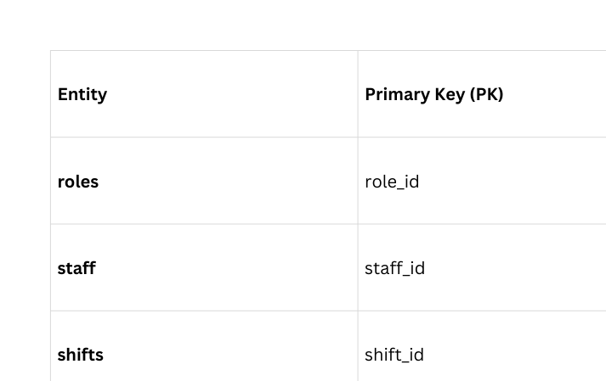
DATABASE DESIGN AND STRUCTURE
The database, cafe_staff_management_db, is modeled using four main tables to capture the essential entities and relationships.
CONCEPTUAL DESIGN

Slide 4
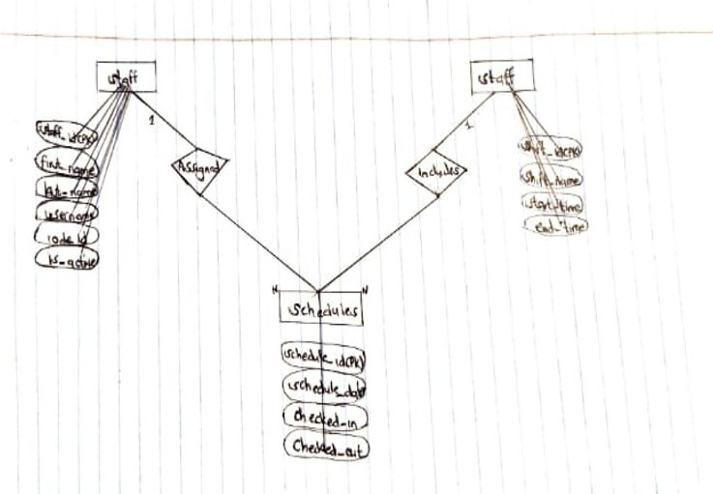
CHEN NOTATION ER DIAGRAM

Slide 5
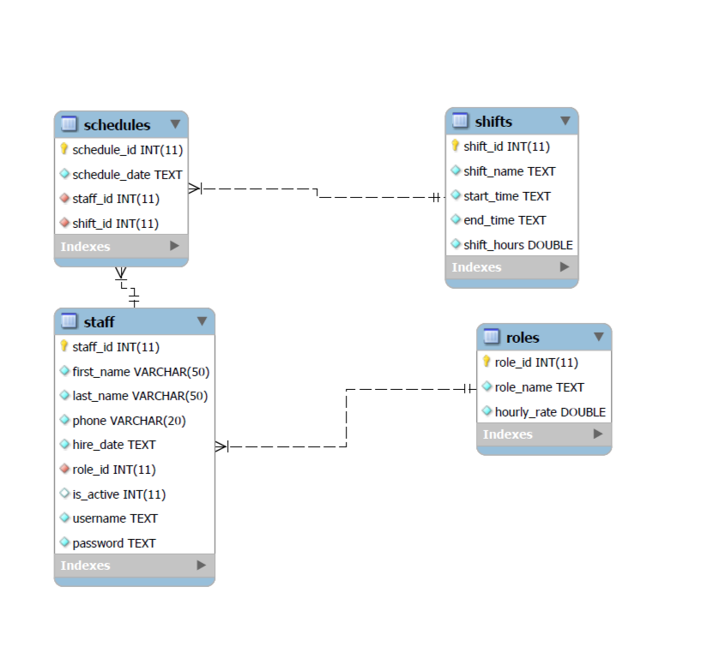
CROW’S FOOT NOTATION ERD

Slide 6
SAMPLE SQL CODE (DDL, DML)
(DATA DEFINITION LANGUAGE - DDL)
INITIAL DATA POPULATION (DML)
CREATE TABLE STAFF
(
STAFF_ID INTEGER AUTO_INCREMENT PRIMARY KEY,
FIRST_NAME VARCHAR (50) NOT NULL,
LAST_NAME VARCHAR (50) NOT NULL,
PHONE VARCHAR (20) NOT NULL,
HIRE_DATE TEXT NOT NULL,
ROLE_ID INTEGER NOT NULL,
IS_ACTIVE INTEGER DEFAULT 1,
USERNAME TEXT UNIQUE NOT NULL,
PASSWORD TEXT NOT NULL,
FOREIGN KEY (ROLE_ID) REFERENCES ROLES (ROLE_ID)
);
#INSERT INTO TABLE SHIFTS
INSERT INTO SHIFTS (SHIFT_ID, SHIFT_NAME, START_TIME, END_TIME, SHIFT_HOURS)
VALUES
(1, 'MORNING', '06:00:00', '14:00:00', 8.0),
(2, 'MID-DAY', '10:00:00', '18:00:00', 8.0),
(3, 'CLOSING', '14:00:00', '22:00:00', 8.0);

Slide 7
VIEWS AND STORED PROCEDURES
VIEWS SIMPLIFY COMMON QUERIES USED FOR DASHBOARDS AND REPORTS.
STORED PROCEDURES (SPS) ENFORCE KEY BUSINESS RULES AND AUTOMATE COMPLEX CALCULATIONS.
UPCOMING_WEEKLY_SCHEDULE: SHOWS SHIFTS SCHEDULED FOR THE NEXT SEVEN DAYS.
SP_ASSIGNSTAFFSHIFT: HANDLES THE ENTIRE PROCESS OF SCHEDULING A STAFF MEMBER FOR A SPECIFIC SHIFT ON A DATE.
//VIEW CREATION:
UPCOMING_WEEKLY_SCHEDULE AS
SELECT
SC.SCHEDULE_DATE, S.FIRST_NAME, S.LAST_NAME, SH.SHIFT_NAME, SH.START_TIME, SH.END_TIME
FROM
SCHEDULES SC
JOIN
STAFF S ON SC.STAFF_ID = S.STAFF_ID
JOIN
SHIFTS SH ON SC.SHIFT_ID = SH.SHIFT_ID
WHERE
SC.SCHEDULE_DATE BETWEEN CURDATE() AND DATE_ADD(CURDATE(), INTERVAL 7 DAY)
ORDER BY SC.SCHEDULE_DATE, SH.START_TIME;
//STORED PROCEDURES:
CREATE DEFINER=`ROOT`@`LOCALHOST` PROCEDURE `SP_ASSIGNSTAFFSHIFT`(
IN P_STAFF_ID INT,
IN P_SHIFT_ID INT,
IN P_SCHEDULE_DATE DATE
)
BEGIN
INSERT INTO SCHEDULES (STAFF_ID, SHIFT_ID, SCHEDULE_DATE)
VALUES (P_STAFF_ID, P_SHIFT_ID, P_SCHEDULE_DATE);
END

Slide 8
WEB INTERFACE INTEGRATION
Three-Tier Architecture
Frontend (HTML/CSS): User-friendly forms for staff registration and shift assignments.
Backend (PHP): Processes requests and communicates with the MySQL database using secure methods.
Database (MySQL): Stores all schedules, staff details, and shift durations.
Core Functional Modules
Admin Dashboard: Centralized view to manage the employee roster and organize shifts.
Staff Portal: Secure registration and real-time viewing of upcoming schedules.
Automated Workflow: Forms (like mark_attendance.html) send POST requests to PHP scripts, which update the database instantly.

Slide 9
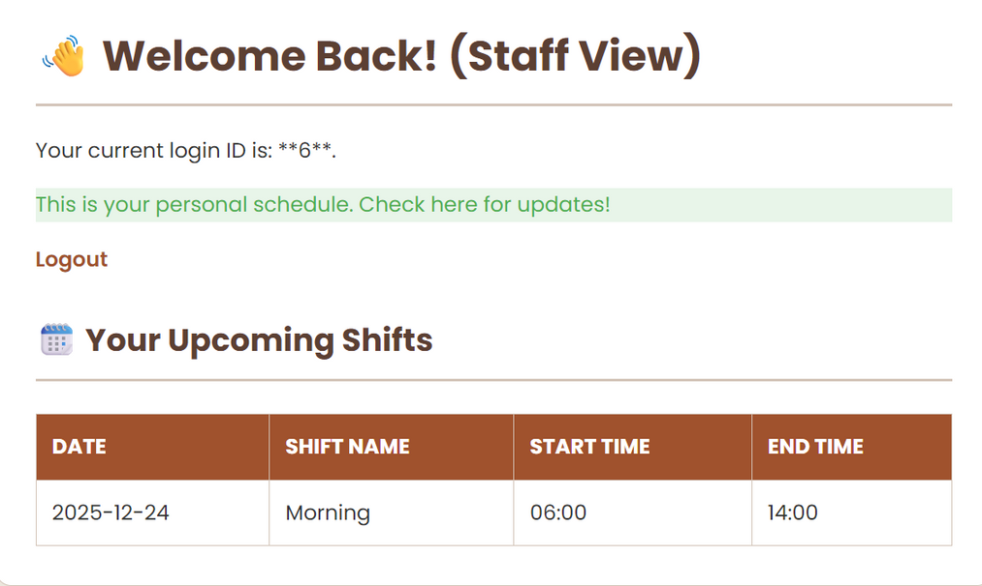
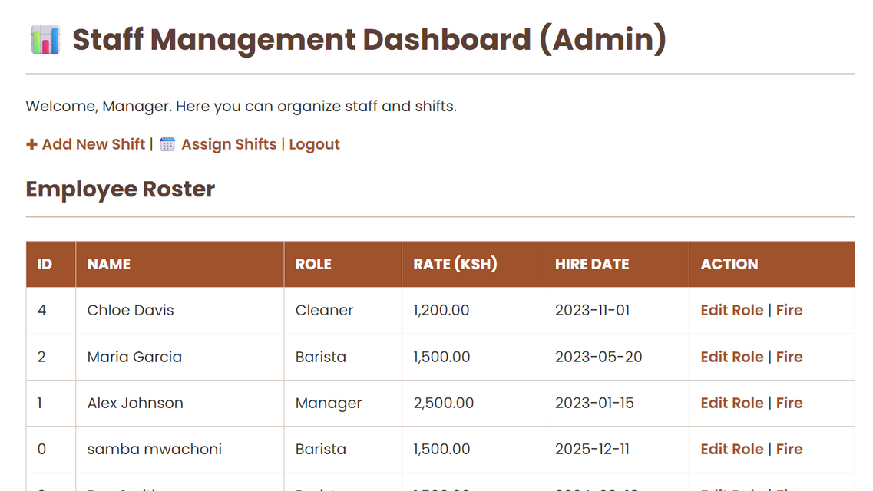
STAFF AND ADMIN DASHBOARD WED INTERFACE

Slide 10
CHALLENGES & SOLUTIONS
Challenge: Foreign Key constraints prevented deleting staff members.
Solution: Implemented SET FOREIGN_KEY_CHECKS = 0 for maintenance and ensured "orphan" schedules were cleaned up.
CONCLUSION & SYSTEM BENEFITS
The Staff Shift Scheduling and Management System successfully replaces manual cafe logs with a secure, automated database solution. By integrating MySQL, PHP, and a Web Interface, the system ensures structural integrity through proper data relationships and provides real-time oversight for cafe managers.

Slide 11
THANK
You

